Slide 1
Midterm Check-In
By: Shale & Omar

Slide 2
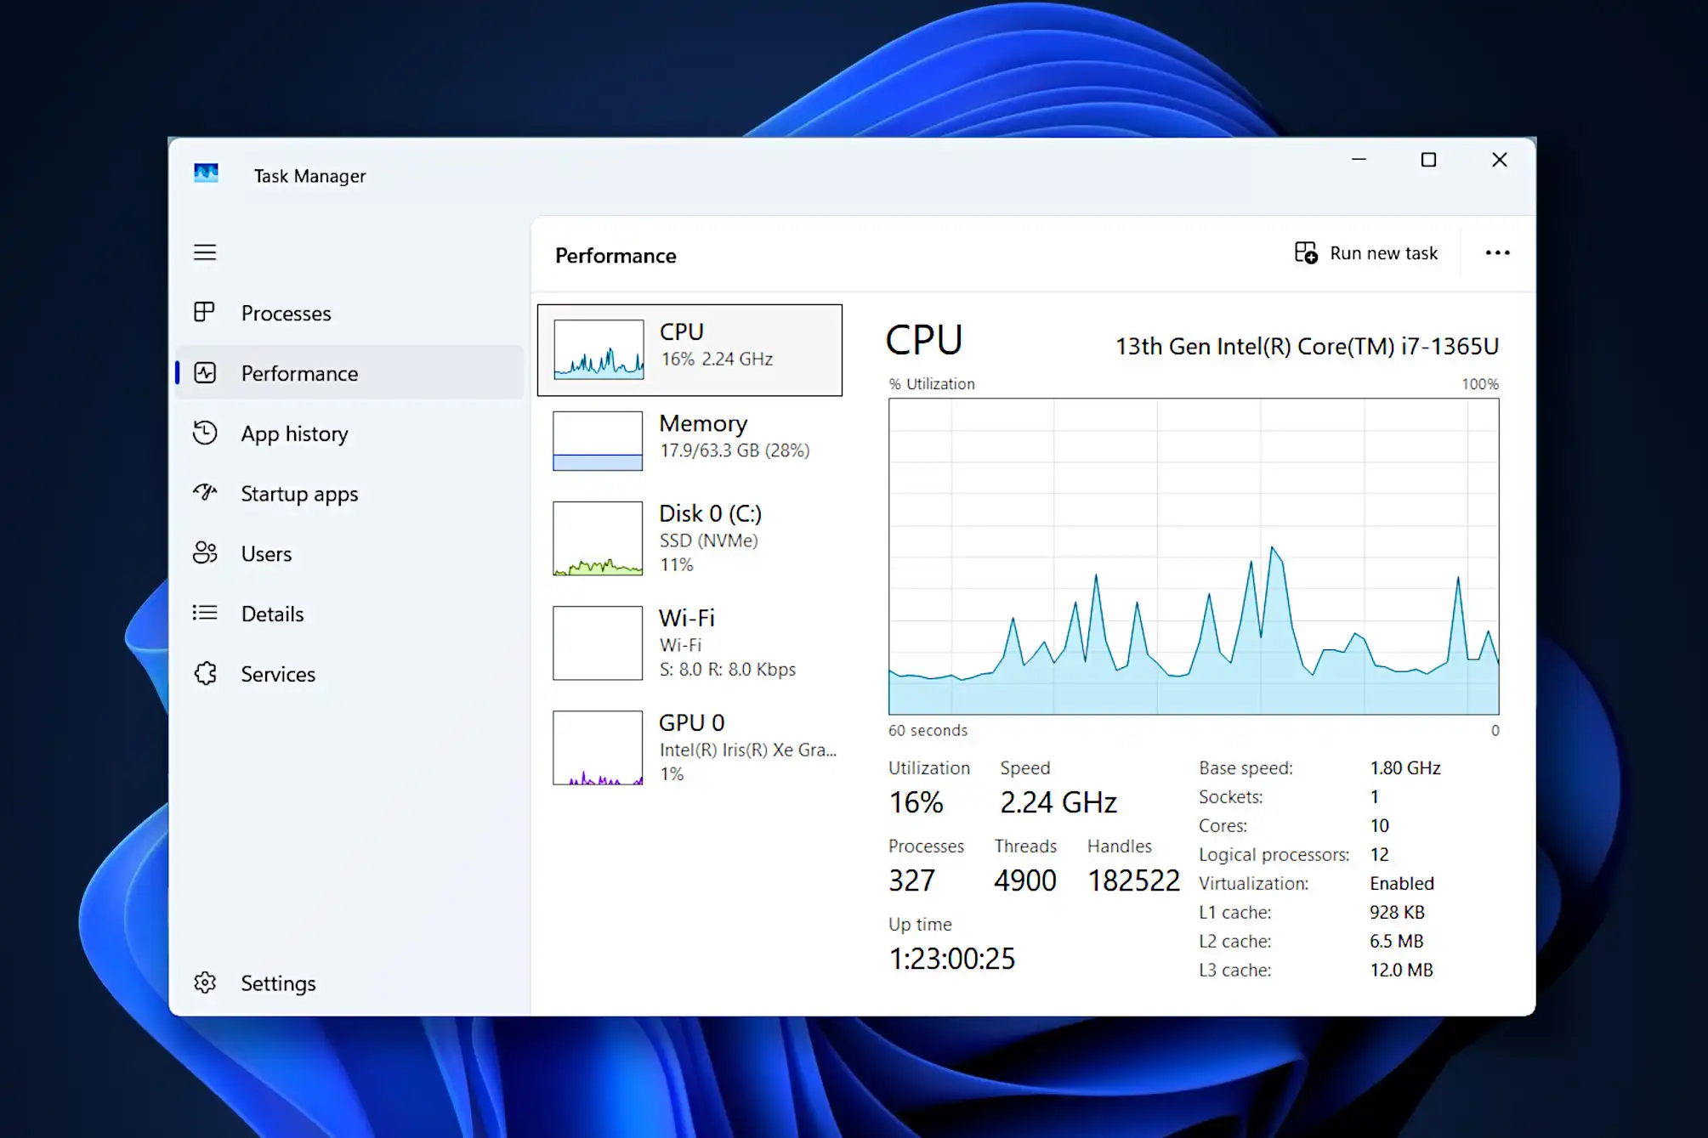
What is this project about?
Programs (Web Browsers, File Readers, etc) use RAM, CPU, Disk, GPU, etc
Typically CPU usage, Disk usage, RAM usage are referred to as resource usage
All models are no exception to this, because they are programs
Aim to reduce resource usage of multiple tasks for a limited computational facility.

Slide 3
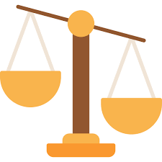
An Aside on Load Balancing…
Distributing traffic across multiple servers to ensure the best possible performance
In our case its to reduce resource usage, so speed or latency isn’t too important right now
The idea is to predict how much resources will be used, allocate appropriately

Slide 4
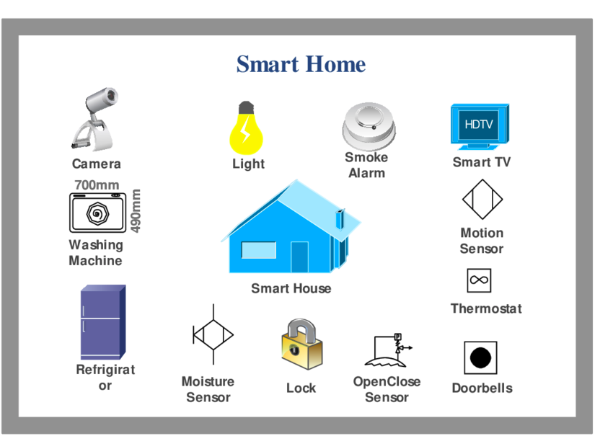
Why do this in the first place?
Many environments have limited computing capabilities
IoT is one type place that can benefit from adaptive allocation
It’s novel! This approach is unique for load balancing

Slide 5
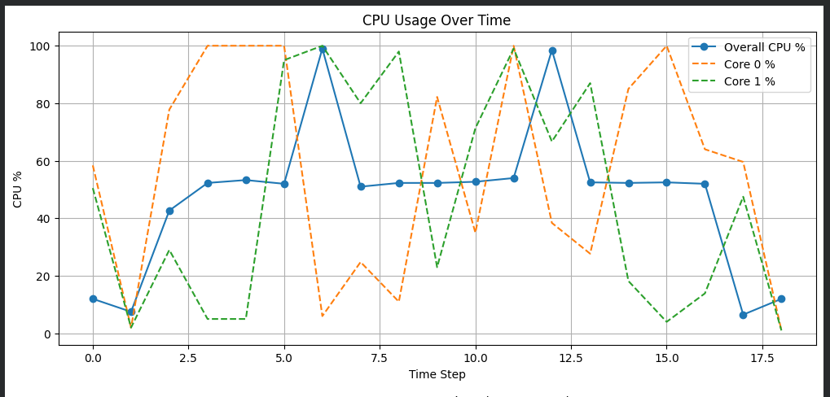
What has been done so far?
Profiled memory usage of Gemma AI model (gemma-3-1b-it)
Prompted AI model with data from Google (bigbench)
Visualized the CPU and Memory usage of the Gemma model

Slide 6

What are some next steps / possible approaches?
Get a few more models
  Each will have a different use (Evaluation, Prompt Splitting, etc)
Set up some models over the network
  Pass messages between containers/machines about resource usage
Learn more about typical load balancing strategies/algorithms
  e.g. Round Robin, Weighted Round Robin, Least Response Time, etc

Slide 7

Fin, Any questions?

